Slide 1
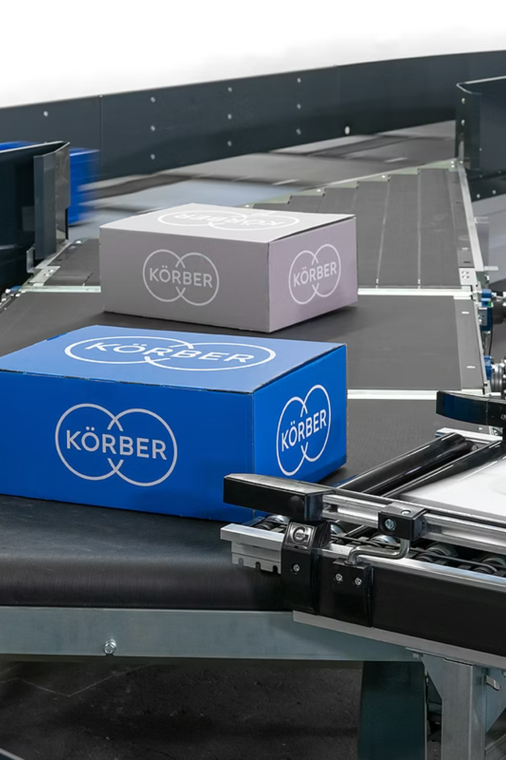
Körber WMS: Transforming Warehouse Audit & Compliance
Explore how the Körber Warehouse Management System (WMS) with its advanced Audit & Compliance Suite is revolutionizing warehouse operations.
Presented by: Saran Chandrasekharan Unnithan
Notes:
Good evening, everyone. Today I’ll be presenting on how the Körber Warehouse Management System—specifically its Audit & Compliance Suite—transforms warehouse operations, increases quality, and reduces errors. As part of my final Advanced Quality Control course presentation, I’ve chosen Körber because of its strong reputation and real-world impact in logistics, 3PL operations, and supply chain automation.”

Slide 2




Industry Problem: Warehouses Lose $60B Yearly from Errors
Significant Financial Losses
Operational Inefficiencies
Lack of Real-time Visibility
Global warehouses annually incur over $60 billion in losses due to prevalent issues like inventory inaccuracies, mis-picks, and compliance failures.
The increasing complexity of orders combined with critical labor shortages severely impacts operational efficiency and productivity.
Absence of transparent, real-time data leads to critical performance bottlenecks and untraceable errors, hindering effective decision-making.
Notes:
Warehousing faces a major global challenge—errors cost the industry over $60 billion every year. These include mis-picks, mis-shipments, non-compliance issues, inventory inaccuracies, and safety violations. As order volumes and SKU complexity rise, so do these losses. The core problem is lack of real-time visibility and inconsistent audit practices across processes and shifts.

Slide 3

Current Gaps
Manual Audit Processes
Traditional manual audits create significant inconsistencies and delays in quality reporting, making it difficult to maintain standards.
High Mis-pick Rates
Inadequate validation checkpoints during picking lead to high mis-pick rates, directly affecting order accuracy and customer satisfaction.
Cycle Counting Errors
Frequent errors in cycle counting processes compromise inventory accuracy, leading to stock discrepancies and impacting customer service.
Lack of Standardized Documentation
Absence of standardized compliance documentation across different shifts and operations creates regulatory risks and inefficiencies.
Notes:
Most warehouses still rely on manual audits, which are prone to human error and inconsistencies. Mis-picks often go undetected until late in the fulfillment process. Cycle counts are inaccurate because they’re often performed in batches or irregularly. Compliance tracking is inconsistent, especially across multiple shifts. These gaps impact accuracy, customer satisfaction, and operational reliability

Slide 4
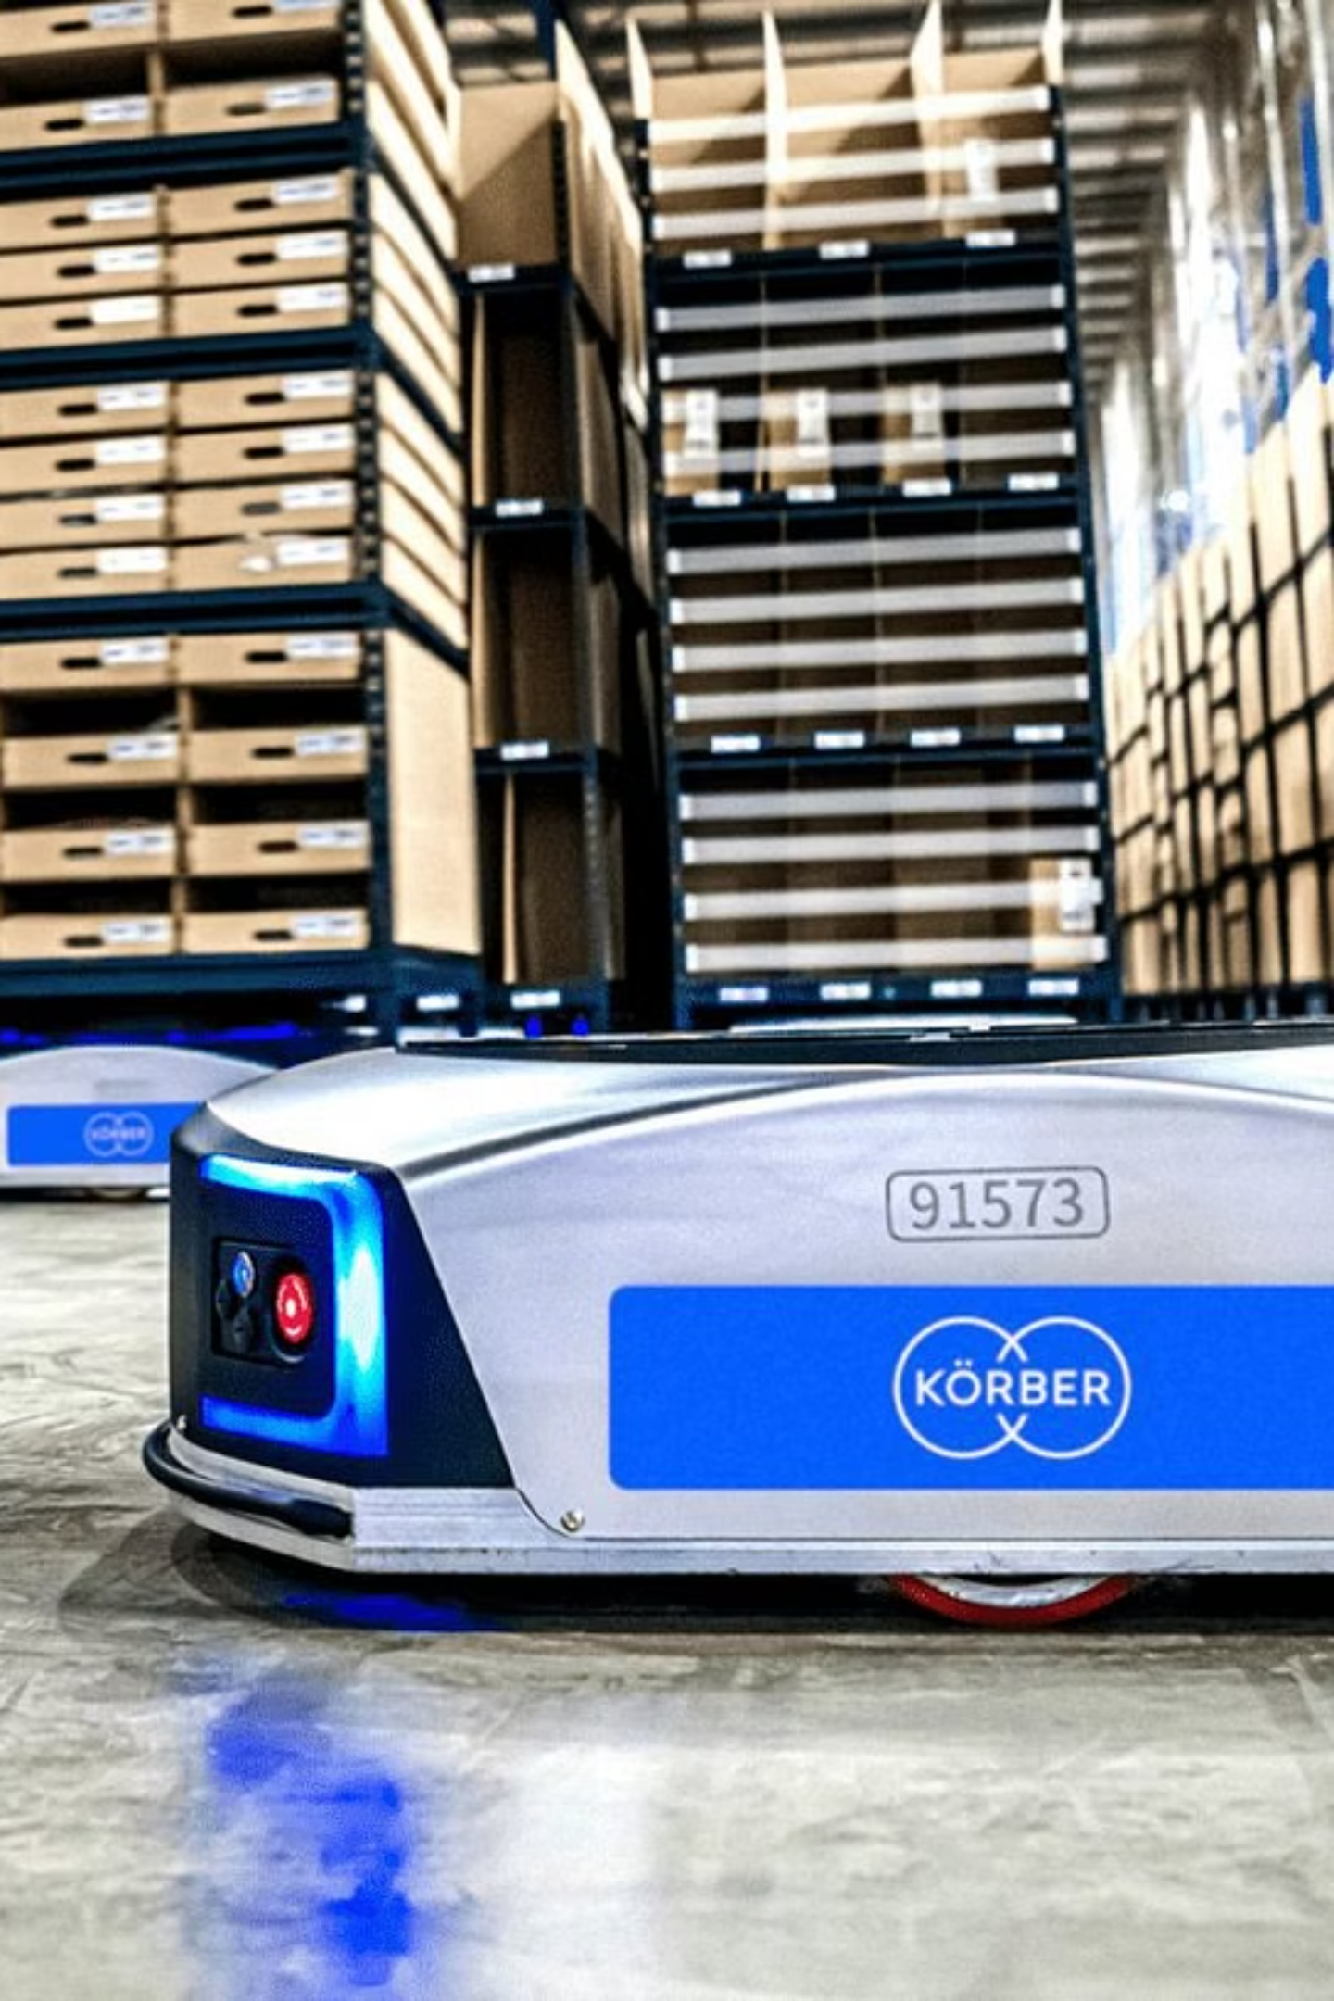
Körber WMS's End-to-End Warehouse Control
Körber WMS is a modular and scalable Warehouse Management System, trusted globally by 3PLs, manufacturers, and retailers for comprehensive operational control.
Automated Processes: Streamlines and automates critical warehouse functions, including receiving, put-away, picking, packing, and shipping.
Integrated Technology: Seamlessly integrates with cutting-edge robotics, IoT sensors, and existing ERP systems for a unified ecosystem.
Optimized Workflows: Ensures standardized and optimized workflows across all operational areas, driving efficiency and reducing errors.
Notes:
Körber WMS is a modular, scalable platform used worldwide by manufacturers, retailers, and especially 3PLs. It manages the entire warehouse lifecycle—from receiving to shipping. It integrates directly with robotics, conveyors, AMRs, and ERP systems. The key advantage is its ability to standardize and automate workflows, reducing variability and improving quality across processes

Slide 5
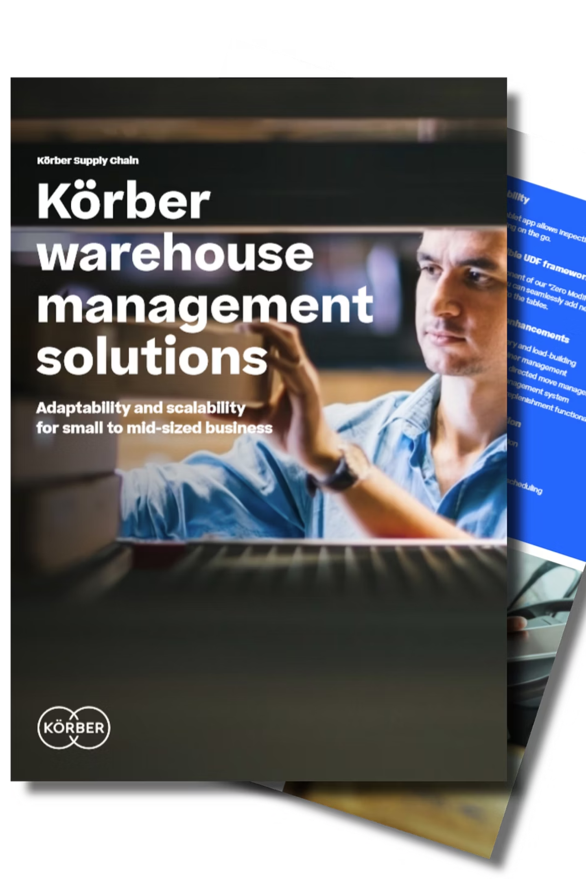




Built-in Audit Suite : Process, Safety & Operational Audits
Configurable Templates
Utilize flexible audit templates tailored for process efficiency, safety protocols, and regulatory compliance.
Automated Triggers
Benefit from automated audit triggers based on predefined deviations or critical events, such as mis-picks or equipment malfunctions.
Digital Compliance
Ensure digital checklist compliance for industry standards like OSHA, ISO, and internal Standard Operating Procedures (SOPs).
Root-Cause Analytics
Gain deeper insights with root-cause analytics directly embedded into workflow processes for continuous improvement.
Notes:
One standout feature is Körber’s integrated Audit & Compliance Suite. This suite enables digital audits for process compliance, safety checks, and operational adherence. Audits can be triggered automatically when deviations occur—for example, repeated mis-picks or equipment issues. Everything is captured digitally, ensuring compliance with OSHA, ISO, and internal SOPs. This creates consistency that manual audits cannot achieve.”

Slide 6

Real-Time Dashboard : Error Hotspots & KPI Monitoring
Körber WMS provides intuitive visual dashboards that offer a clear overview of your warehouse operations, enabling proactive management.
Error Hotspot Identification: Instantly pinpoint error hotspots across various zones, shifts, or Stock Keeping Units (SKUs).
Key Performance Indicator Tracking: Monitor critical KPIs such as accuracy rates, cycle count variances, pick errors, and audit completion status.
Live Exception Monitoring: Improve decision-making with live exception monitoring, allowing for immediate corrective actions.
Mobile Accessibility: Access dashboards on the go with mobile-enabled features, empowering supervisors with real-time insights from anywhere.
Notes:
Körber provides real-time dashboards that visualize error hotspots by zone, shift, or SKU. Supervisors get immediate visibility into KPIs such as cycle count variance, pick accuracy, audit completion rates, and inventory discrepancies. With live exception alerts, teams can correct issues before they escalate, shifting from reactive firefighting to proactive quality control

Slide 7

Business Impact
40%
20%
35%
Accuracy Increase
Labor Reduction
Disruptions Decrease
Automated validation significantly boosts inventory accuracy and eliminates manual audit efforts.
Workflow automation reduces labor dependency, optimizing workforce utilization and costs.
Proactive error detection and compliance management cut down operational disruptions and violations.
These improvements collectively lead to better OTIF (On-Time In-Full) performance and heightened customer satisfaction.
Notes:
Automated audits and workflow validation significantly improve performance. Organizations typically see up to a 40% improvement in accuracy, 20% labor reduction through automation, and a 35% decrease in disruptions such as rework, compliance violations, and process deviations. This directly impacts OTIF metrics and customer satisfaction.

Slide 8
Use Case : How a 3PL Improved OTIF Using Körber
A prominent Third-Party Logistics (3PL) provider faced significant challenges with inconsistent picking quality and consequently, low On-Time In-Full (OTIF) delivery rates.
The Solution
By implementing Körber's advanced audit suite, the 3PL gained the ability to perform real-time mis-pick validation, revolutionizing their quality control.
The Impact
Enhanced visibility led to proactive corrections, reducing errors before they impacted delivery.
OTIF performance dramatically improved by 18% within just three months.
Automated error detection capabilities significantly reduced labor hours, optimizing operational costs.
Notes:
Here’s a real-world example: A large 3PL was struggling with inconsistent quality and a low OTIF score. After implementing Körber’s audit suite, every mis-pick triggered a real-time validation and correction process. Within three months, OTIF improved by 18%, labor hours dropped, and supervisors gained clear visibility into root causes. This demonstrates Körber’s practical and measurable impact

Slide 9
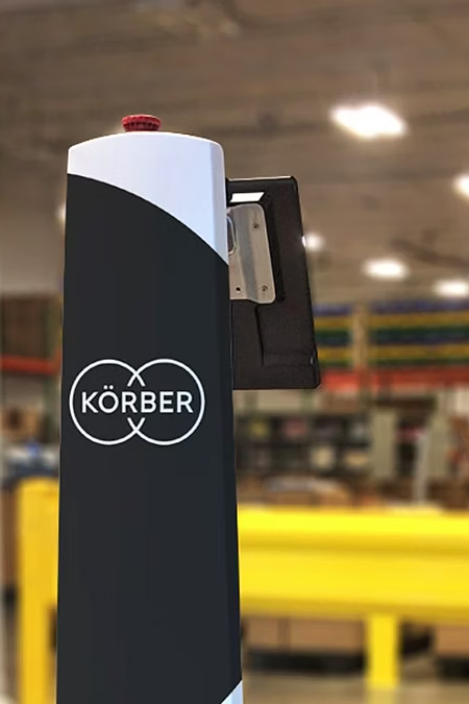
How Körber Beats Other WMS Audit Solutions
Deeply Integrated Workflows
Unlike external modules, Körber's audit capabilities are built directly into the WMS, ensuring seamless operation.
Robotics Compatibility
Offers strong compatibility with modern automation and robotics, maximizing operational efficiency.
Flexible Configuration
Provides flexible configuration options to meet industry-specific compliance requirements.
Advanced Analytics
Delivers superior analytical capabilities compared to outdated legacy systems, empowering data-driven decisions.
Notes:
Compared to other systems, Körber stands out because its audit tools are deeply integrated—not an add-on or separate module. It’s highly configurable and scalable for different industries. Its compatibility with automation and robotics also puts it ahead of older legacy systems. The analytics capabilities make it superior for continuous quality improvement

Slide 10

Final Pitch : ROI + Implementation Strategy
Achieve Rapid Return on Investment
Structured Implementation Strategy
Körber WMS typically delivers a full ROI within a short period of 12 to 18 months, proving its value quickly.
Process Mapping: Standardize and optimize existing Standard Operating Procedures (SOPs).
Configuration: Tailor audit templates to your specific needs.
Integration: Seamlessly connect with ERP systems and automation technologies.
Training & Deployment: Comprehensive training followed by phased deployment for smooth adoption.
Investing in Körber WMS drives long-term reliability, ensures robust compliance, and significantly reduces operational costs, securing your future in a competitive market.
Notes:
Körber WMS delivers ROI within 12–18 months through accuracy, compliance, and labor savings. A successful implementation starts with process mapping and standardizing SOPs, followed by configuring audit templates and integrating with ERP systems. A phased deployment ensures minimal disruption. The result is a warehouse that’s more reliable, compliant, and cost-effective

Slide 11
References
Körber Supply Chain Official Documentation
https://koerber-supplychain.com/supply-chain-solutions/supply-chain-software/warehouse-management/
Industry Reports: WERC, MHI Annual Industry Report
https://fonsecaadvisers.com/wp-content/uploads/2025/05/MHI-industry-report-2025.pdf
Case Studies: Körber Client Success Stories
https://www.koerber.com/en/insights-and-events/case-studies
Notes:
These references include official Körber documentation, industry reports from WERC and MHI, and real case studies. They support the data and examples I’ve shared throughout this presentation. Thank you

